Slide 1
Representational state transfer (REST)

Slide 2
REST(REpresentational State Transfer)
REST is the protocol used for interaction with the Web from constrained devices.
The main aim of the REST was to simplify the web-application development and interaction.
Layering in the application architecture should be supported and each of the layers shall be independent
Layering is supported, and hence intermediaries should be transparent. (meaning they should not disrupt the fundamental principles of REST)
Should be based on client-server architecture and the servers should be stateless.
Support should be provided for caching at the client side.
Since transactions are stateless, all interactions should be context-free
The interface to servers should be generic and standardized (URI- A URI is a string of characters that uniquely identifies a particular resource.)

Slide 3
REST(REpresentational State Transfer)
Everything on the Internet is a resource. The resources can be Text Files, Html Pages, Images, Videos or Dynamic Business Data.
Unique identifiers are available to identify the resources
Generic and simple interfaces are available to work with those resources
Communication between client and servers can be through representation of resources.
For eg. A client can ask for JSON representation whereas another client may ask for XML representation of the same resource to the server and so on. It is the responsibility of the REST server to pass the client the resource in the format that the client understands.
Resource representation through sequence of bytes is followed by some metadata explaining the organization of the data

Slide 4
REST(REpresentational State Transfer)
The previous constraints and principles bring in many advantages to the distributed applications:
They are scalability, loose coupling, better security, simple addressability, connectedness, and performance.

Slide 5
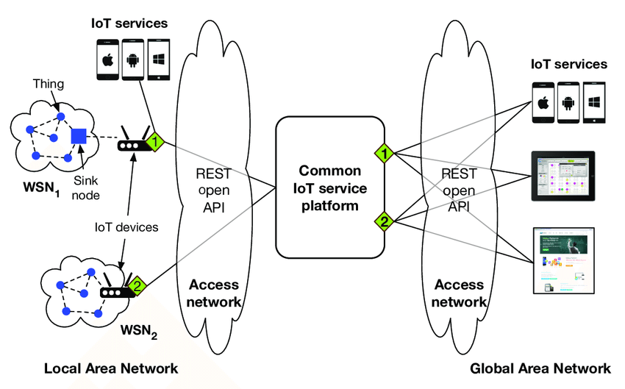
Requirements-of-providing-the-common-IoT-service-platform-and-REST-open-API-to-make-it

Slide 6
CoAP
Constrained Application Protocol (CoAP) is a specialized web transfer protocol for use with constrained nodes and constrained networks in the Internet of Things.
Application layer usually employ HTTP to provide web service, but HTTP has high computation complexity
CoAP is designed to enable simple, constrained devices to join the IoT even through constrained networks with low bandwidth and low availability.
It is generally used for machine-to-machine (M2M) applications such as smart energy and building automation.

Slide 7
CoAP
In contrast to HTTP,
The CoAP has four types of messages: Acknowledgement, Reset, Confirmable (CON), and NonConfirmable (NON).
The non-confirmable messages are used to allow sending requests that may not require reliability. Reliability is provided by the message layer and will be activated when Confirmable messages are used.
The Request methods used in CoAP are: GET, POST, PUT, and DELETE of HTTP

Slide 8
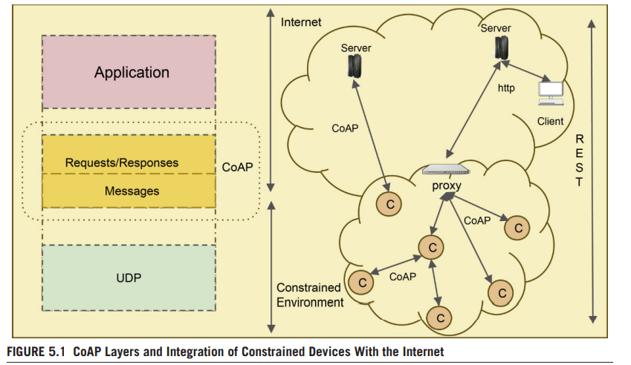
CoAP

Slide 9
Advantages of CoAP
A compact binary header (10–20 bytes), along with UDP, reduces the communication overhead, thereby reducing the delay and minimizing the power consumption due to data transmission.
Since asynchronous data push is supported, it enables things to send information only when there is a change of observed state. This allows the things to sleep most of the time and conserve power.
The minimal subset of REST requests supported by CoAP. This allows the protocol implementations to be less complex when compared to HTTP.
This lowers the hardware requirements for the smart things on which it executes

Slide 10
Comparison of HTTP and CoAP
CoAP is cost-effective whenever the battery/power-source replacements prove costly.
Whenever the charges for the data communication are volume-based, CoAP is found to be more cost-effective
CoAP has been found to be more beneficial cost-wise in push mode than in pull mode.
CoAP is using similar features to HTTP but also allows for low overhead, multicast, etc.
HTTP is based on TCP protocol , But CoAP operates over UDP

Slide 11
CoAP Vs HTTP
CoAP (Constrained Application Protocol) and HTTP (Hypertext Transfer Protocol) are both application layer protocols used in the context of the Internet of Things (IoT) and other constrained environments. However, they have different characteristics and use cases.
Purpose and Use Cases:
CoAP: CoAP is designed for use in constrained environments, such as IoT devices with limited resources (e.g., low power, memory, and processing capabilities). CoAP is more efficient for applications on smart objects, engaged in frequent communication sessions. It is optimized for constrained power and processing capabilities of IoT
HTTP: HTTP is a general-purpose protocol used for communication between web clients and servers in a wide range of applications, including web browsing, APIs, and traditional web services.

Slide 12
Transport Protocol:
CoAP: CoAP typically uses UDP (User Datagram Protocol) as its transport protocol, which is lightweight and connectionless. It's well-suited for environments where reliability can be traded for reduced overhead.
HTTP: HTTP primarily uses TCP (Transmission Control Protocol) as its transport protocol, which offers reliable, connection-oriented communication. TCP ensures data integrity but comes with higher overhead.

Slide 13
Message Format:
CoAP: CoAP messages are designed to be compact and efficient, using a binary format. This reduces the overhead compared to the text-based format of HTTP.
CoAP exchanges messages asynchronously and uses UDP.
HTTP: HTTP messages are text-based, making them more human-readable but less efficient in terms of size. Here messages exchanges are synchronously.

Slide 14
Request-Response Model:
CoAP: CoAP follows a request-response model similar to HTTP, with methods like GET, POST, PUT, and DELETE. However, CoAP's messages are optimized for minimal overhead and reduced complexity.
HTTP: HTTP also follows a request-response model with a richer set of methods. It is designed for general-purpose web communication.

Slide 15
Resource Identification:
CoAP: CoAP uses URIs (Uniform Resource Identifiers) for resource identification, similar to HTTP.
HTTP: HTTP uses URLs (Uniform Resource Locators) for resource identification. These are more human-friendly and can include domain names.

Slide 16
Security:
CoAP: CoAP can be secured using Datagram Transport Layer Security (DTLS), a protocol similar to TLS but adapted for UDP. Security can be a concern in IoT environments, and CoAP provides mechanisms for securing communication.
HTTP: HTTP can also be secured using TLS (Transport Layer Security), which provides secure communication over TCP. TLS is widely used for securing web communication.

